Slide 1


An Economic Perspective on Predictive Maintenance of Filtration Units Presented by: Tan Jing Yu, Denis Supervisor: Assoc Prof Law Wing-Keung, Adrian

Slide 2
Presentation Outline
1 Introduction
2 Literature Review
3 Methods
4 Results
5 Discussion
6 Conclusion and Future Work

Slide 3
INTRODUCTION
1

Slide 4
Introduction
Background and current trends
Research gaps
Scope of study

Slide 5
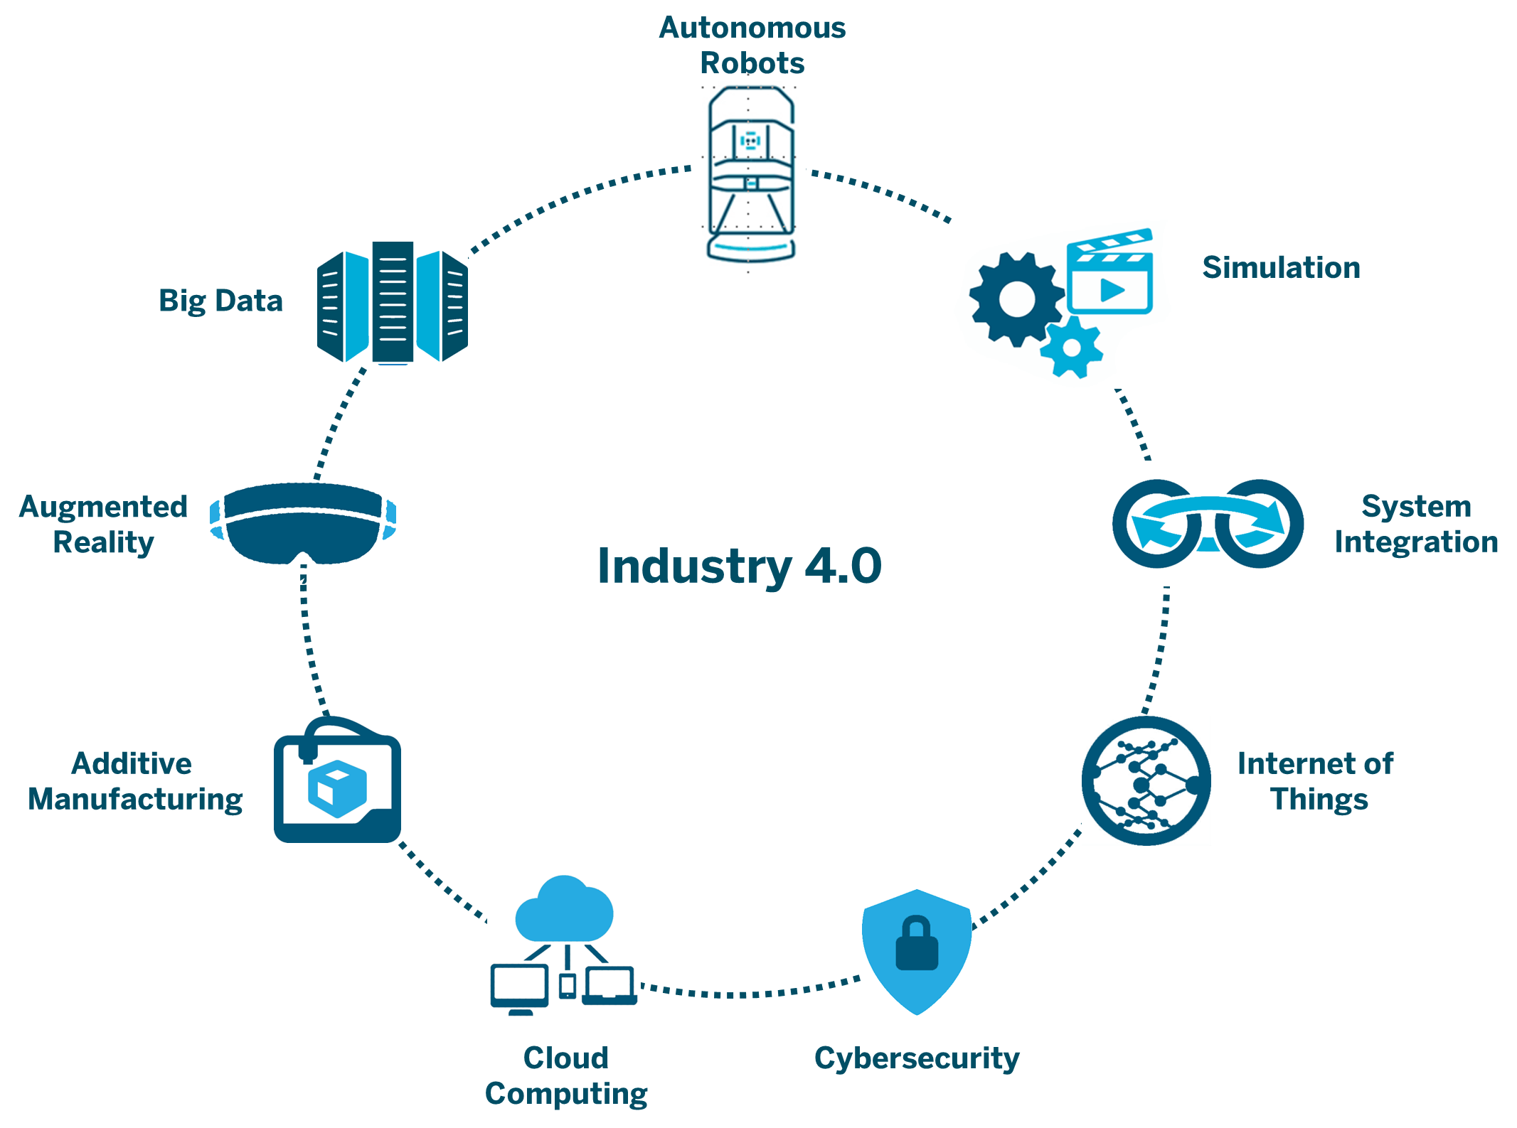
Background and current trends
Advancement of industry 4.0 and inexpensive sensors
Fusion machines with data
Improve overall performance and maintenance management
Benefits of predictive maintenance
Real-time remote monitoring of physical assets
Live tracking of products
Streamlining the entire production process
Adoption rate remains low
Only 35% of industry players deploy advanced statistical modeling or machine learning for predictive analytics
Source: Emory University Future of IIoT Research Study and Presenso

Slide 6

Research gaps
Technical implementation
Abundance of research papers
Provide detailed methods describing the use of statistical modeling, time series forecasting, or machine learning to predict faults
Business implementation
Little research or literature on business or economic perspectives
Justify the economic value of a predictive maintenance program

Slide 7
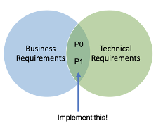


Scope of study
Technical and business aspects
Water treatment industry
Proof of concept
Focus is on bridging the gap between the two aspects
Ultra-filtration stage
Machine learning models and financial model

Slide 8
LITERATURE REVIEW
2

Slide 9
Literature Review
Common maintenance strategies
Rise of predictive maintenance

Slide 10

Background and common maintenance strategies
Maintenance as a core operation
Maintenance operations take up around 15% to 70% of the companies’ overall expenses
Increasingly competitive landscape
Need to constantly find ways to cut costs or risk losing to competitors
Pressure to improve overall performance and maintenance management
Common strategies adopted by companies
Corrective maintenance and preventive
Suffer from a lack of foresight

Slide 11

Rise of predictive maintenance
Enabling factors of predictive maintenance
Push factor: weaknesses of corrective maintenance and preventive maintenance
Pull factor: prevalence of big data and advancement of industry 4.0
Abundance of research on data-centric approach
Rule-based methods
Estimation-based methods
Time-series-based methods
Learning-based methods

Slide 12
METHODS
3

Slide 13
Methods
Experiments and data collection
Predictive maintenance model development
Financial modeling
Linking predictive maintenance model to financial model

Slide 14


Experiments and data collection
Approach
Focus
Value simulation
Data collection
Attack scenarios performed using the human machine interface
Stage P3: ultra-filtration
Sensor: differential pressure indicator transmitter (DPIT301)
DPIT301 values were simulated to specific values for 5 times
Comma-separated values (CSV) file
8701 rows and 82 columns

Slide 15
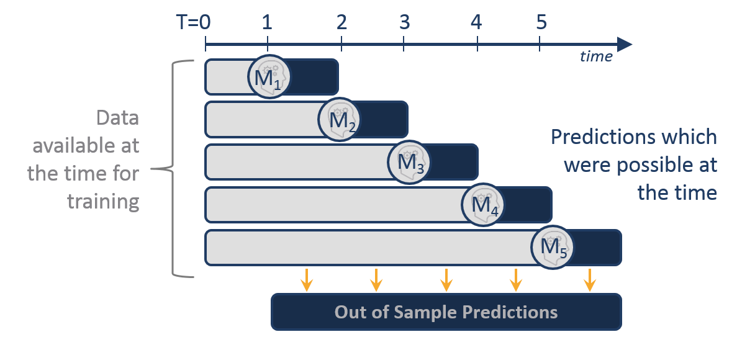

Predictive maintenance model development
DataFrame
Remove null and “Bad Input” values
Conversion of data types
Data loading and cleaning
Exploratory data analysis
Data preprocessing
Time series split
Model building and evaluation
Linear regression
Random forest regressor
Gradient boosting regressor
Evaluation metric: root mean square error (RMSE)
Time series plots
Stage 3 (ultra-filtration)
Feature selection
Feature extraction (Lag 5 to lag 30)
Multiple training and test sets
A total of 5 splits (6 portions; 1-1; 2-1; 3-1; 4-1; 5-1

Slide 16

Financial modeling
Definition
Financial modeling is the task of building an abstract representation (a model) of a real world financial situation. This is a mathematical model designed to represent (a simplified version of) the performance of a financial asset or portfolio of a business, project, or any other investment.
Applications
Estimate the valuation of a business, compare businesses to their peers in the industry, strategic planning to test various scenarios, calculate the cost of new projects, decide on budgets, allocate corporate resources

Slide 17
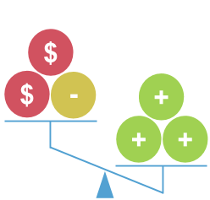
Cost benefit analysis
What is it?
Process by which organizations can analyze decisions, systems or projects, or determine a value for intangibles.
Model is built by identifying the benefits of an action as well as the associated costs, and subtracting the costs from benefits.
Completion of a cost benefit analysis will yield concrete results that can be used to develop reasonable conclusions around the feasibility of a decision.

Slide 18

Cost benefit analysis
When to use?
Developing benchmarks for comparing projects
Deciding whether to pursue a proposed project
Evaluating new hires
Weighing investment opportunities
Measuring social benefits
Appraising the desirability of suggested policies
Assessing change initiatives
Quantifying effects on stakeholders and participants

Slide 19
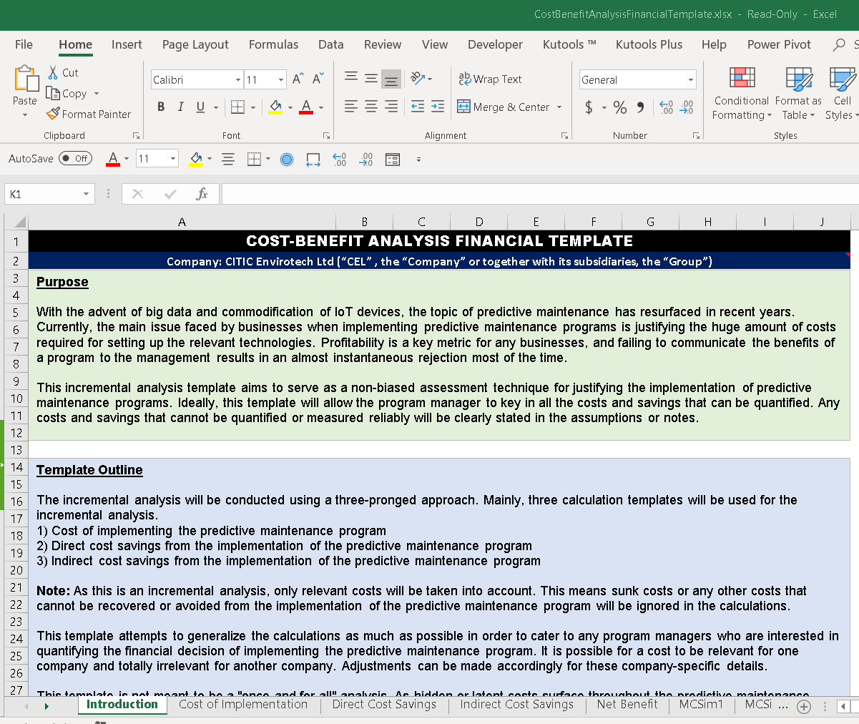
Cost benefit analysis
Microsoft Excel
3 main spreadsheets + 1 consolidated spreadsheet
Cost of implementation
Direct cost savings
Indirect cost savings
Net benefit
Referenced company
CITIC Envirotech Ltd: membrane-based integrated environmental solutions provider

Slide 20
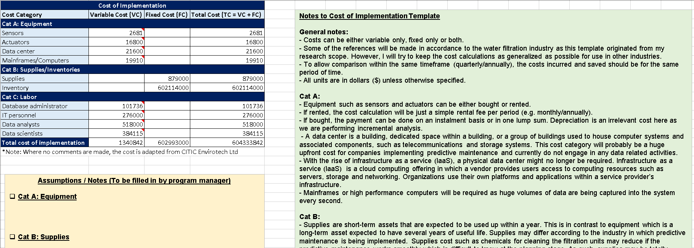
Cost of implementation

Slide 21
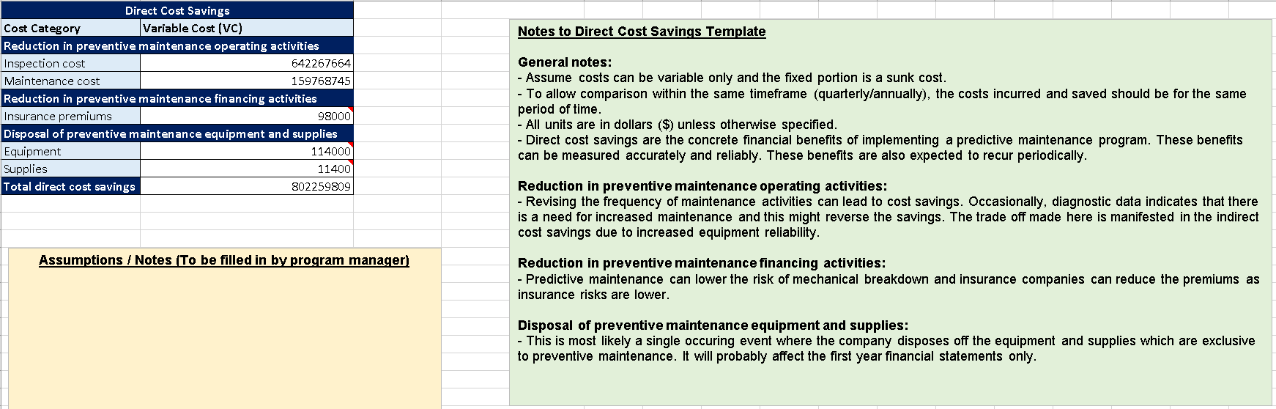
Direct cost savings

Slide 22
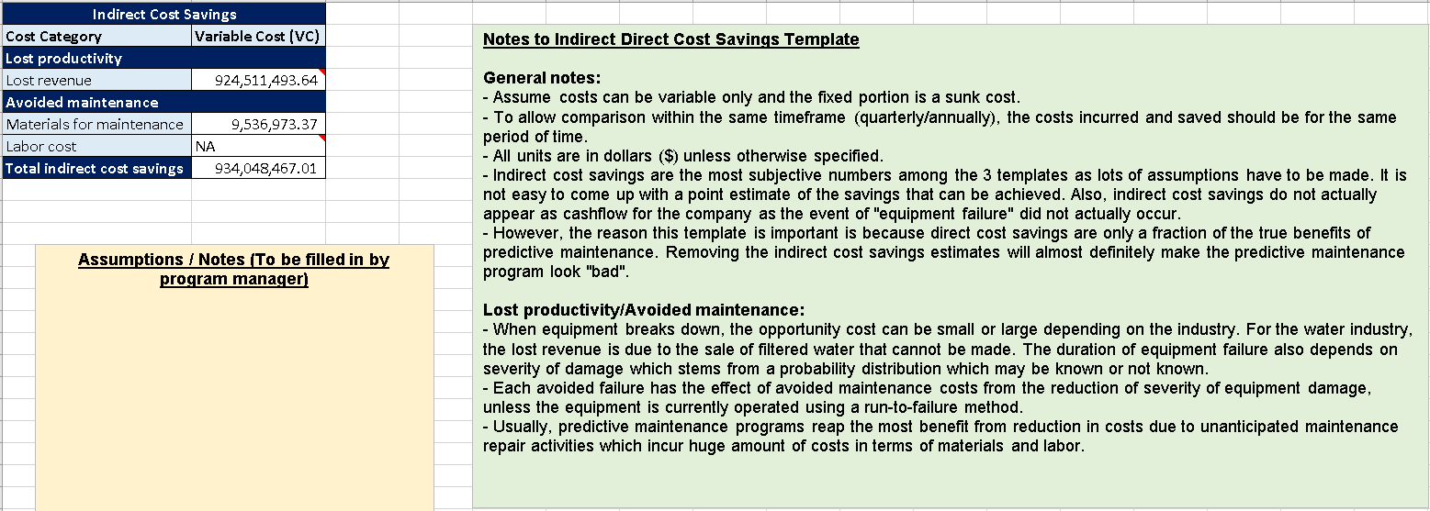
Indirect cost savings

Slide 23
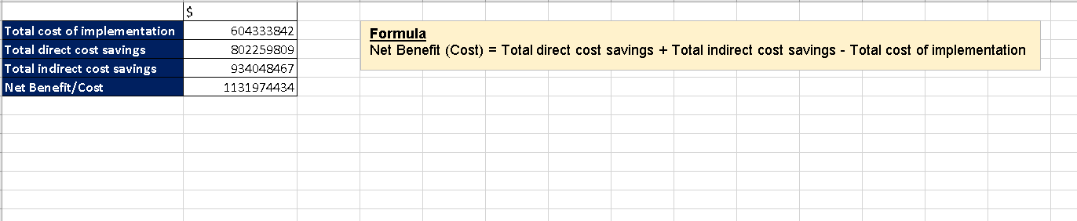
Net benefit/cost

Slide 24
Monte Carlo simulation
Definition
A technique used to understand the impact of risk and uncertainty in financial, project management, cost, and other forecasting models
Suitable subcategories
Direct cost savings
Inspection cost savings
Maintenance cost savings
Indirect cost savings
Avoidance of lost revenue
Materials cost savings

Slide 25
Linking predictive maintenance model to financial model
First scenario
Avoidance of maintenance due to the predictive maintenance model signaling that no fault is likely to occur in the next X period
Second scenario
Avoidance of unanticipated breakdown

Slide 26
RESULTS
4

Slide 27
Results
Machine learning models evaluation
Monte Carlo simulation results

Slide 28

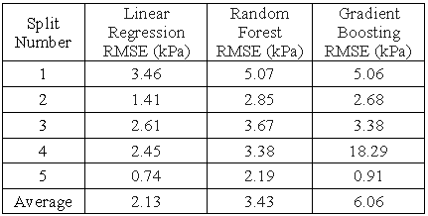
Machine learning models evaluation
Evaluation metric
The trained machine learning models were evaluated using root mean square error (RMSE) on the test set at each split
Ranking of models (Based on average RMSE)
Rank 1: Linear regression
Rank 2: Random forest regressor
Rank 3: Gradient boosting regressor

Slide 29
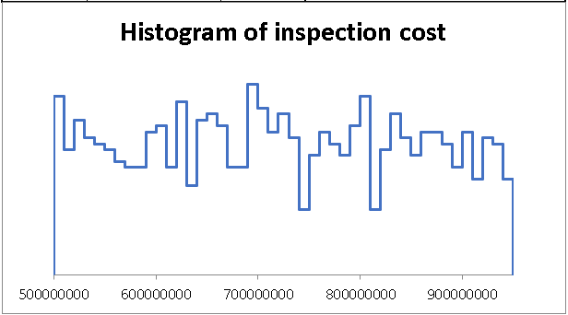
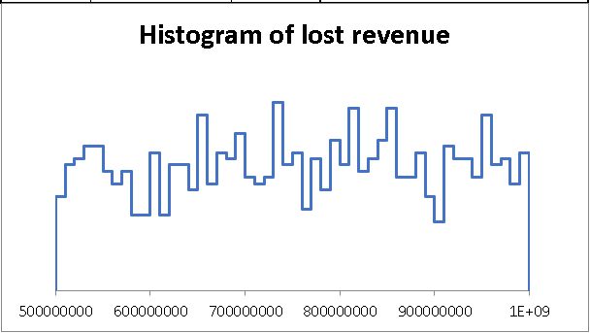
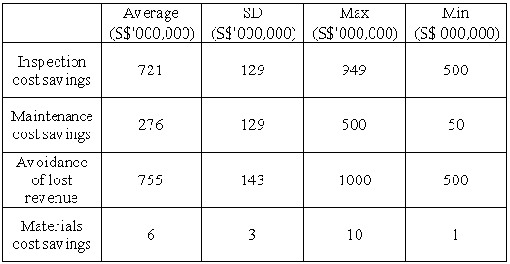
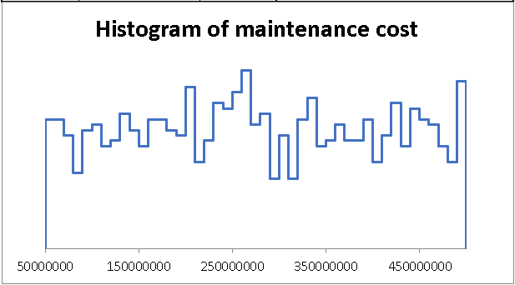
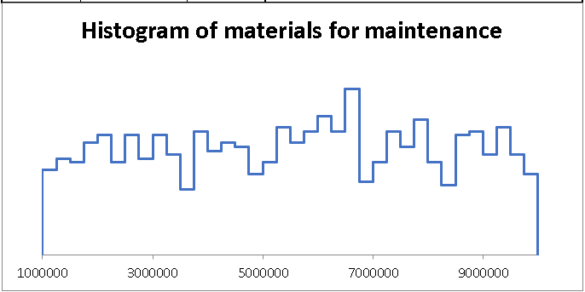
Monte Carlo simulation results

Slide 30
DISCUSSION
5

Slide 31
Discussion
Implications of study
Limitations of study

Slide 32

Implications of study
Key points
Model development process was satisfactory and served its purpose in illustrating the proof of concept (reasonable RMSE).
Cost-benefit analysis financial template provided a structured way for managers to document all the potential costs and savings of the predictive maintenance program.
Monte Carlo simulation was proposed as an added function to the cost-benefit analysis financial template.
Models the inherent risk that most or all real-world companies face
Encapsulates the risk of machine learning models (Link back to the 2 scenarios)
Presence of a probability distribution improves cost and savings transparency

Slide 33

Limitations of study
Key points
Conducted using a proof of concept approach
Findings are mostly theoretical
Reality could pan out very differently for companies
Data obtained from the testbed was not representative of an actual water treatment
Physical process was extremely stable as it was not treating water for public or industrial use
Cost-benefit analysis might not be sufficient for large publicly listed companies.
High opportunity costs for funds, could have been used for other investment purposes
Discounted cash flow (DCF) analysis would be more suitable for these companies. DCF analysis evaluates an investment today based on future cash flows. However, it is difficult for an outsider to obtain a company’s required rate of return on investment for DCF analysis.

Slide 34
CONCLUSION AND FUTURE WORK
6

Slide 35

Conclusion
Key points
Proof of concept approach deployed in this study has shown the immense potential of predictive maintenance in the water treatment industry
Machine learning models
Cost benefit analysis coupled with Monte Carlo simulation
Wider industry outlook for predictive maintenance is also very optimistic with the rise of industry 4.0 and the availability of inexpensive sensors
Study has shown how to bridge the gap between the technical and business domains of predictive maintenance

Slide 36

Future work
Key points
Collaborating with an actual water treatment company to obtain more realistic data
Start a pilot program
Deep understanding of a business could lead to a more successful implementation of predictive maintenance
Cost-Sensitive Learning for Predictive Maintenance (Stephan Spiegel, Fabian Mueller, Dorothea Wiesmann)
Created a custom cost function to optimize
Model is trained to maximize the savings instead of traditional metrics like accuracy, RMSE etc.

Slide 37
THANKS!
Any questions?

